Slide 1



K.RAMAKRISHNAN COLLEGE OF ENGINEERING
(Autonomous)
Department of Mechanical Engineering
(Batch 2024 – 2028)
MEB1225-STRENGTH OF MATERIALS (TCPR)
( Project Work)
Year / Sem: II / IV
Final review
Date:06/05/2026
Project Title: | FABRICATION AND STUDY OF SAWDUST REINFORCED EPOXY COMPOSITE
TEAM MEMBERS
ROLL NO | Reg. No | NAME OF THE MEMBER
ME2444 | 8115U24ME044 | PREM ANANTH M
ME2460 | 8115U24ME060 | UMESH K S
ME2450 | 8115U24ME050 | SANTHOSH KUMAR M
LME2465 | 8115U24ME301 | ARJITH
Guide Name | Designation | Signature
Mr M.MANIMARAN M.E.,(phd) | ASSISTANT PROFESSOR

Slide 2
CONTENTS
PARTICULARS | SLIDE NUMBER
Introduction | 3
Literature review | 4
Literature summary | 5
Problem Identification | 6
Objectives | 7
Methodology | 8
Design of 2D DIAGRAM | 9
Design of 3D DIAGRAM | 10
List of components & Material selection | 11
Working process | 12
Draft Budget | 13
Gantt Chart | 14
Conclusion | 15
References | 16
Thank you | 17

Slide 3
INTRODUCTION
INTRODUCTION:
Sawdust reinforced epoxy composite is a sustainable material made by mixing wood waste (sawdust) with epoxy resin. It helps reduce environmental waste while producing a low-cost and lightweight composite.
The fabrication is done using simple methods like hand lay-up, and the material is studied for properties such as strength and durability, making it useful for furniture and basic structural applications.

Slide 4
LITERATURE REVIEW
LITERATURE SURVEY
Sawdust is used as a natural filler in epoxy composites due to its low cost and eco-friendly nature.
Studies show it improves properties like thermal insulation and reduces material cost.
Mechanical properties such as strength and hardness depend on the amount of sawdust added.
Excess sawdust reduces strength due to weak bonding with the epoxy resin.

Slide 5
LITERATURE SUMMARY
LITERATURE SURVEY
Previous studies highlight that sawdust reinforced epoxy composites are eco-friendly and cost-effective materials, utilizing wood waste while reducing environmental impact.
Research findings show that adding an optimal amount of sawdust improves properties like stiffness, hardness, and insulation, making the composite suitable for lightweight applications.
However, literature also concludes that excessive sawdust content leads to poor bonding and reduced mechanical strength, indicating the need for proper composition balance.

Slide 6
PROBLEM IDENTIFICATION
Conventional materials used in manufacturing are often costly and non-biodegradable, leading to environmental concerns and the need for sustainable alternatives.
Wood waste like sawdust is generated in large quantities but is not effectively utilized, causing disposal and pollution problems.
There is a lack of optimized composition and understanding of how sawdust affects the mechanical properties of epoxy composites, which limits its practical applications.

Slide 7
OBJECTIVE
To fabricate sawdust reinforced epoxy composite using simple and effective methods.
To utilize sawdust as a low-cost and eco-friendly reinforcing material.
To study the mechanical properties such as strength and hardness of the composite.
To analyze the effect of different proportions of sawdust in the epoxy matrix.
To develop a lightweight and cost-effective material for engineering applications.

Slide 8
METHODOLOGY
Collection and preparation of sawdust by drying and sieving to obtain uniform particle size.
Mixing of epoxy resin and hardener in the required ratio to form the base matrix.
Gradual addition of sawdust into the epoxy mixture with proper stirring for uniform distribution.
Pouring the mixture into a mould and allowing it to cure using the hand lay-up method.
Testing the fabricated composite for mechanical properties such as strength

Slide 9
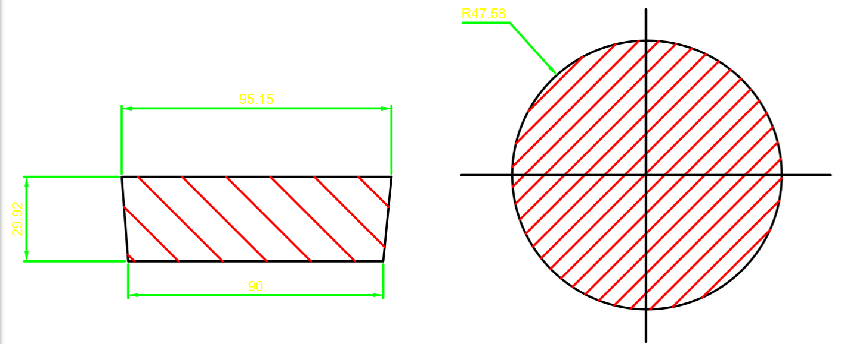
DESIGN ( 2D DIAGRAM )

Slide 10
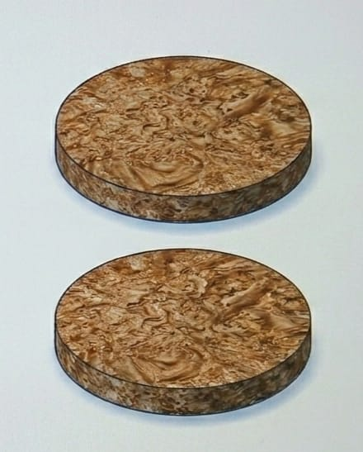
DESIGN ( 3D DIAGRAM )

Slide 11
LIST OF COMPONENTS & MATERIALS
Materials:
Epoxy Resin
Hardener
Sawdust
Selection Justification:
The main components used in the fabrication of sawdust reinforced epoxy composite are epoxy resin, hardener, and sawdust. Epoxy resin acts as the base matrix material that binds all components together, while the hardener is added to initiate the curing process and provide strength. Sawdust is used as a reinforcing filler material, which helps in reducing cost and improving certain properties like stiffness, making the composite more eco-friendly and efficient.

Slide 12
WORKING PROCESS
Preparation of sawdust by drying and sieving to remove moisture and get uniform size.
Mixing of epoxy resin and hardener in the correct ratio to form the base matrix.
Addition of sawdust into the mixture with proper stirring for even distribution.
Pouring into mould, curing, and then removing the final composite for testing

Slide 13
DRAFT BUDGET
Epoxy Resin (500g): ₹270
Hardener: ₹100
Mould Preparation:100
Sawdust(Local): ₹10
Testing Charges (Tensile and hardness): ₹400
Total Estimated Budget: ₹880 (Approx.)
FRONT VIEW (Fig:2)

Slide 14
GANTT CHART
3D TOTAL MODEL
Week 1: Literature Review & Problem Identification
Week 2: Design and Planning of Composite
Week 3: Material Procurement
Week 4: Fabrication of Composite Material
Week 5: Curing and Finishing Process
Week 6: Testing & Data Collection
Week 7: Analysis and Report Preparation

Slide 15
CONCLUSION
DESIGN LAYOUT FOR THE SYSTEM
The fabrication and study of sawdust reinforced epoxy composite show that sawdust can be effectively used as a low-cost and eco-friendly reinforcing material in epoxy composites. The developed material exhibits satisfactory mechanical properties, depending on the proportion of sawdust added, and is suitable for lightweight and moderate strength applications. This project highlights the potential of utilizing wood waste to produce sustainable and economical composite materials for engineering uses.

Slide 16
REFERENCES
Callister, W.D., Materials Science and Engineering: An Introduction, Wiley Publication.
Mallick, P.K., Fiber-Reinforced Composites: Materials, Manufacturing, and Design, CRC Press.
Agarwal, B.D., Broutman, L.J., Analysis and Performance of Fiber Composites, Wiley.
Research articles on natural fiber reinforced composites from journals like Composites Science and Technology.

Slide 17
THANK YOU!!

